Slide 1
Lecture 4
Basic concept of deduction

Slide 2
Last Lecture
A word (or group of words) is vague when its meaning is fuzzy and inexact.
A word is over general if they provide is too broad and unspecific in given context.
A word is ambiguous if it has two or more distinct meanings and the context does not make clear which meaning is intended.
A simple way to avoid unclear and imprecise words is to provide definition. .

Slide 3
In this lecture, you will able to…
Know what is deductive argument.
Know the types of deductive argument.
Identify deductive argument.

Slide 4
Arguments
Induction
Deduction
Common Patterns
Common Patterns
Truth and Validity
Inductive Strength

Slide 5
Types of Argument
An argument is a set of statements to provide good reasons (premises) for a claim (conclusion).
How to provide?
How does a conclusion flow from the premises?
Deductively and Inductively

Slide 6
Types of Argument
What is Deductive Argument?
Each conclusion is logically necessary derived from the premises
Given the premises are true, the conclusion could not possibly be false.
The denial of conclusion would fall into contradiction.
Deductive arguments are intended to provide conclusive support for their conclusions.
Necessary = 100%

Slide 7
Types of Argument
Examples:
All humans are mortal. Socrates is human. Therefore, Socrates is mortal
He is studying at Southern University College. So he must be a college student.
Tun Mahathir was PM immediately before Tun Abdullah. Tun Abdullah was PM immediately before Datuk Seri Najib. Hence, Tun Mahathir was PM before Datuk Seri Najib.
If you have scars on your body, then you have been abducted by space aliens. You obviously do have scars on your body. Therefore, you have been abducted by space aliens.

Slide 8
Types of Argument
Inductive Argument:
Each conclusion is probably derived from the premises
Given the premises, the conclusion could possibly be false
Inductive arguments are intended to provide probable support for their conclusions.
Not necessary 100%

Slide 9
Types of Argument
Examples:
Every previous Prime Minister have been a man. Therefore, it is likely that the next Prime Minister will be a man.
Since it is raining season. Therefore, there will probably be a rain tomorrow.
More Malaysians die of cancer each year than die in car accidents. Therefore, we should rather take care of our healthy.

Slide 10
Types of Argument
Some logical indicators show the premises and conclusion, however, say nothing about deduction and induction.
Some other indicators tell us about deduction and induction:
Deduction | Induction
Must | Probably
Necessarily | Good
Conclusive | Likely
Impossible | Possible
Guarantee | Probably true

Slide 11
Common Patterns
Categorical Syllogism
Hypothetical Syllogism
Disjunctive Syllogism
Argument based on mathematics
Argument from definition

Slide 12
Patterns of Deduction
(1) Categorical Syllogism
A three-line argument in which each statement begins with the word all, some, or no.
Logical Quantifiers: All, some, no
Categorical Statements:
All humans are mortal.
Some humans are female.
No human are reptile.
Mr. Tan Ming Zheng is human. (All)
Syllogism:
Three-line argument
Two premises and a conclusion

Slide 13
Common Patterns
P1: All sharks are fish
P2: No fish are mammals
C: Therefore, no sharks are mammals
P1: All Malaysians are patriot.
P2: Some patriots live in Johor.
C: Therefore, some Malaysians live in Johor.
P1: All A are B.
P2: No B are C.
C: No A are C.
P1: All A are B.
P2: Some B are C.
C: Some A are C.

Slide 14
Patterns of Deduction
(2) Hypothetical Syllogism
Contain at least one hypothetical or conditional premise.
If…then, only if, unless, insofar as, etc.
Hypothetical (conditional) Statements:
If the match is burning, then there is oxygen in the room.
If I am sick, then I will see doctor.
If it rains, then the floor is wet

Slide 15
Common Patterns
If the match is burning, then there is oxygen in the room.
antecedent
consequent
If the match is burning, then there is oxygen in the room.
There is oxygen in the room if the match is burning.
The match is burning only if there is oxygen in the room.
There is no oxygen in the room unless the match is burning.

Slide 16
Common Patterns
(2.1) modus ponens (affirming the antecedent):
P1: If I am sick, then I will see doctor.
P2: I am sick
C: Therefore, I will see doctor.
P1: If JJPTR collapses, thousand of investors will be effected.
P2: JJPTR collapses.
C: Therefore, thousand of investors will be effected.
P1: If A then B
P2: A
C: Therefore, B

Slide 17
Patterns of Deduction
(2.2) Modus Tollens (denying the consequent):
P1: If JJPTR collapses, thousand of investors will be effected.
P2: Thousand of investors do not effected.
C: Therefore, JJPTR do not collapse.
P1: If we are in Johor Bahru, we are in Johor.
P2: We are not in Johor.
C: Therefore, we are not in Johor Bahru.
P1: If A then B
P2: Not B
C: Therefore, not A

Slide 18
Common Patterns
(2.3) Chain argument:
Three conditional statements link together.
P1: If global warming becomes worse, then the temperature will raise.
P2: If temperature raises, then some animals will extinct.
C: Therefore, if global warming becomes worse, then some animals will extinct.
If A then B
If B then C
Therefore, if A then C

Slide 19
Common Patterns
(3) Disjunctive Syllogism (Argument by Elimination):
Logically rule out various possibilities until only a single possibility remains
The options should exhaust all elements of the set.
P1: Either Shabudin said that the rapist should marry the victim or the media misunderstood his words.
P2: Shabudin did not say that.
C: Therefore, the media misunderstood his words.
P1: Either A or B
P2: Not B
C: Therefore, A

Slide 20

Common Patterns
P1: Either Joe is in the campus or he is at home.
P2: Joe is not at home.
C: Therefore, Joe is in the campus.
Does the first premise exhaust all possibilities?
Vote for Hillary or vote for tyrant!

Slide 21
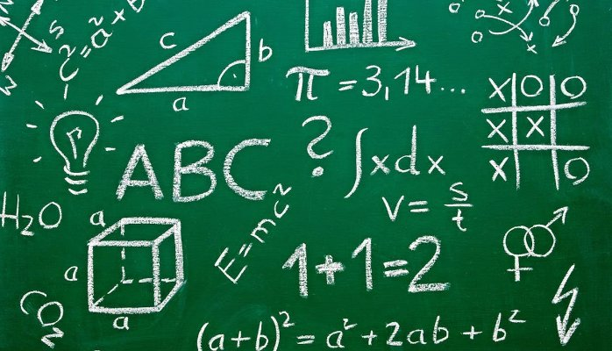
Common Patterns
(4) Argument Based on Mathematics
Proof with mathematical calculation.
Boolean law, Euclid Geometry, etc.
P1: Eight is greater than four.
P2: Four is greater than two.
C: Therefore, eight is greater than two.
P1: There are 8 girls and 13 boys in the class.
C: Therefore, there are 21 students take this course.

Slide 22

Common Patterns
(5) Argument Based on Definition
Conclusion is true by definition
Examples:
Mike is a pediatrician. Therefore, he is a doctor.
He is studying abroad. Therefore, he is a student.

Slide 23
Concluding Remarks
An argument could provide the reasons for the claim deductively or inductively.
For every deduction, each conclusion is logically necessary derived from the premises.
For every induction, each conclusion is probably derived from the premises.
The common patterns for deduction could be categorical syllogism, hypothetical syllogism, disjunctive syllogism, argument based on mathematics, argument from definition.

